Slide 1
Zed Attack Proxy
Gouasmia Zakaria

Slide 2
Web apps are often the best vector to an organization's server/database, an entry point to their entire internal network. By definition, the web app is designed to take an input from the user and send that input back to the server or database. In this way, the attacker can send their malicious input back to the servers and network if the web app is not properly secured.

Slide 3
OWASP is the Open Web Application Security Project, a vendor-neutral, non-profit group of volunteers dedicated to making web apps more secure. As such, they publish their OWASP Top 10 to showcase the most critical vulnerabilities, and have designed WebGoat, a deliberately vulnerable web application for teaching and testing web app security. As part of this effort, they have also developed the OWASP Zed Attack Proxy (ZAP) tool.

Slide 4
OWASP ZAP is a Java-based tool for testing web app security. It has an intuitive GUI and powerful features to do such things as fuzzing, scripting, spidering, proxying and attacking web apps. It is also extensible through a number of plugins. In this way, it is an all-in-one web app testing tool. OWASP ZAP might even become your go-to web app testing tool once you get the hang of it.

Slide 5
In this presentation, we will take a look at this powerful and versatile tool.

Slide 6
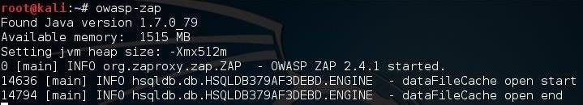
Step 1 : Start OWASP ZAP
If you want to start OWASP ZAP from the command line, you can simply type:
kali > owasp-zap

Slide 7
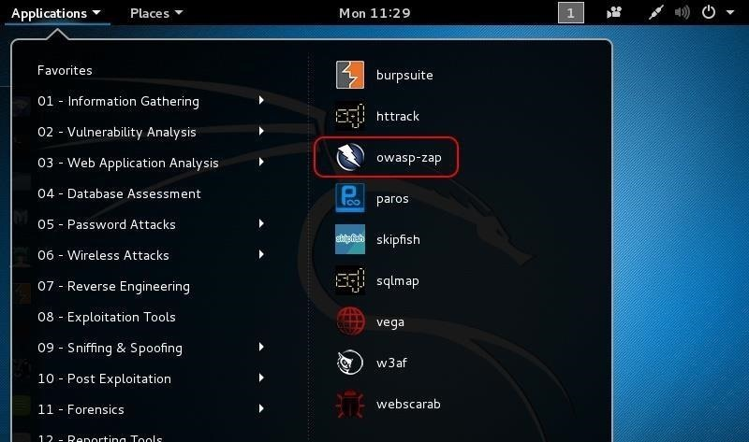
the GUI approach
For those who prefer the GUI approach, go to Applications -> Web Application Analysis -> owasp-zap. Again, be patient, as it will take awhile to load the tool.

Slide 8
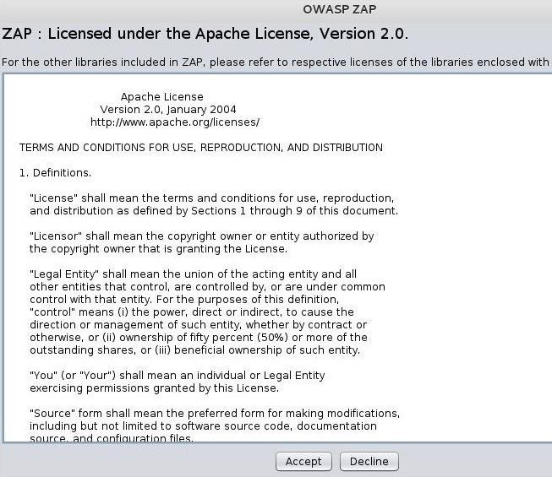
the license
The first thing you will see is the license. Go ahead and accept the terms if you feel comfortable with them. This is a standard Apache license.

Slide 9
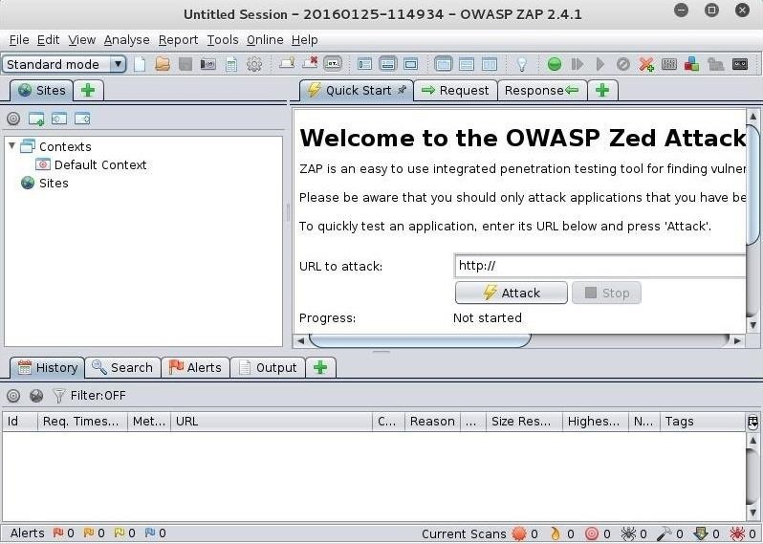
Step 2: The OWASP ZAP Interface
Notes:
When OWASP ZAP eventually opens, it should look like the screenshot below. This tool has many powerful features, but initially, we will only try out its "Attack" function in the large right-hand window. In this mode, OWASP ZAP aggressively goes to the website we designate and begins to look for vulnerabilities.

Slide 10
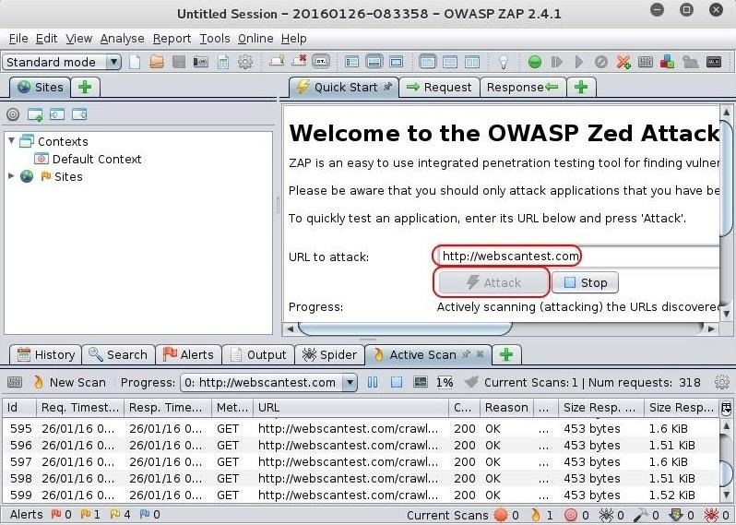
Step 3 : Attacking a Website
Notes:
In this first tutorial, let's test a website initially left vulnerable and safe to test, webscantest.com. Put the URL in the space next to "URL to attack" and then simply click on the "Attack" button below it.
OWASP ZAP will now begin to spider and test the web application for numerous vulnerabilities.

Slide 11
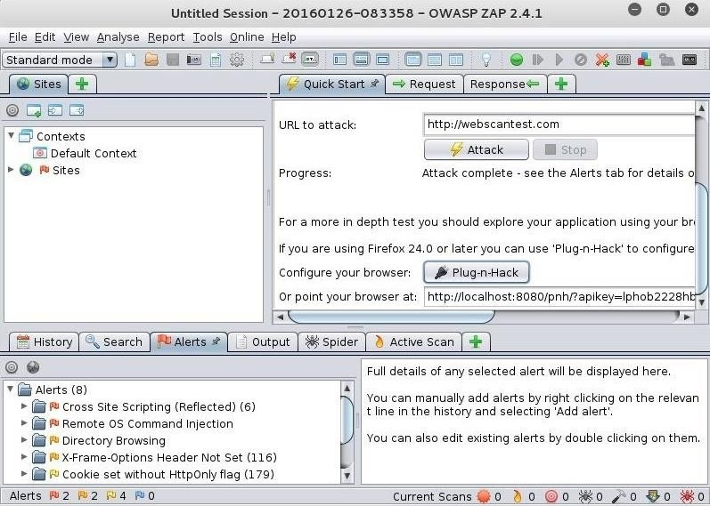
Step 4 : Attack Results & Alerts
Notes:
When it has completed its work (this can be considerable time for large websites), you should see a screen like that below.As you can see in the lower left window, OWASP ZAP has sent us 8 alerts. These alerts are categorized by the type of vulnerability. In this case, these are:
Cross Site Scripting
Remote OS Command Injection
Directory Browsing
X-Frame-Options Header Not Set
Cookie set without HttpOnly flag
Password Autocomplete in browser
Web Browser XSS Protection Not Enabled
X-Content-Type-Options Header Missing

Slide 12
Cross Site Scripting
Remote OS Command Injection
Directory Browsing
X-Frame-Options Header Not Set
Cookie set without HttpOnly flag
Password Autocomplete in browser
Web Browser XSS Protection Not Enabled
X-Content-Type-Options Header Missing

Slide 13
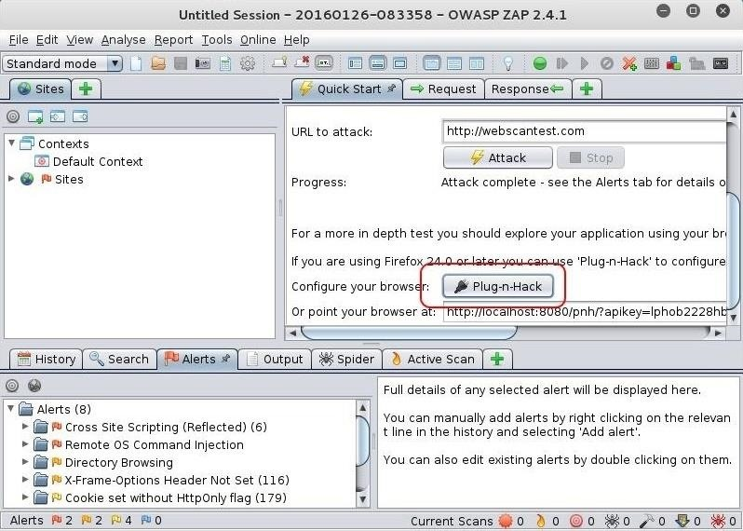
Step 5 :Install the Proxy into Firefox
Notes:
For ease of use, we can install the "Plug-n-Hack" extension in Firefox 24 or later browsers (Iceweasel, the default browser in Kali, is a fork of the Mozilla Firefox project). From the Quick Start menu, you can see the "Plug-n-Hack" button. Simply click on it to install the extension into your browser.

Slide 14
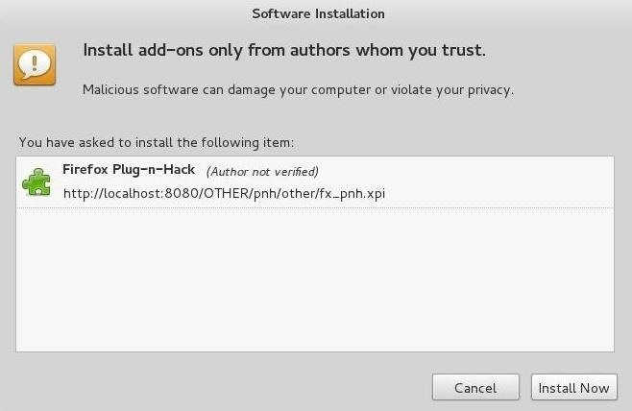
Notes:
Now, you can just use your browser and whatever website you are visiting will be automatically available to the OWASP ZAP application.

